Slide 1
CAR SALES DASHBOARD
Overview and Insights
Presented By: Zainab Khatoon
Batch:pg37

Slide 2
Summary
Objective: Develop an interactive Car Sales Dashboard using Power BI.
Purpose: Visualize key performance indicators (KPIs) for real-time insights into sales performance.
Outcome: Enable data-driven decisions and trend identification.

Slide 3
Problem Statement
Background: Need for effective tracking and analysis of car sales performance.
Objective: Create a dynamic dashboard to visualize critical sales metrics.
Scope: Focus on YTD Total Sales, MTD Total Sales, YOY Growth, and sales trends by body style, colour, and region.

Slide 4
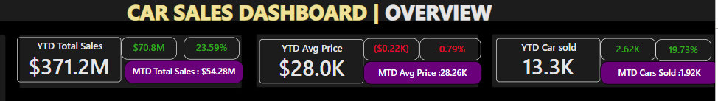
OVERVIEW Problem Statement 1:
KPI’s:
Sales Overview:
Year-to-Date (YTD) Total Sales
Month-to-Date (MTD) Total Sales
Year-over-Year (YOY) Growth in Total Sales
Difference between YTD Sales and Previous Year-to-Date (PTYD) Sales
Average Price Analysis:
YTD Average Price
MTD Average Price
YOY Growth in Average Price
Difference between YTD Average Price and PTYD Average Price
Cars Sold Metrics:
YTD Cars Sold
MTD Cars Sold
YOY Growth in Cars Sold
Difference between YTD Cars Sold and PTYD Cars Sold

Slide 5
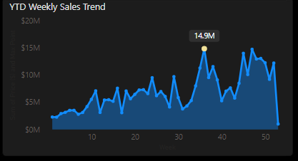
Problem Statement 2
Charts:
YTD Sales Weekly Trend:
A line chart illustrating the weekly trend of YTD sales. The X-axis represent weeks, and the Y-axis show‘s the total sales amount.
Overview:
The graph displays a fluctuating but generally upward trend in weekly sales over the year, peaking around week 40.
Insight:
Identifying peak sales weeks can help in planning marketing campaigns and inventory management.

Slide 6
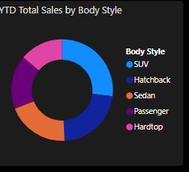
YTD Total Sales by Body Style:
Overview: The pie chart breaks down the total yearly sales by vehicle body style.
Distribution: SUVs are the leading category in sales, followed by sedans and hatchbacks.
Hardtops have the least sales, showing limited consumer preference or availability.
Insight: The popularity of SUVs suggests a shift in consumer preferences towards larger vehicles, which may influence future marketing strategies.

Slide 7
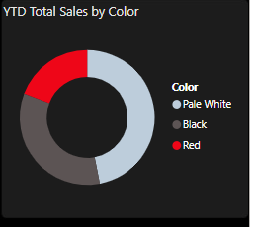
YTD Total Sales by Colour:
Colour Distribution:
Pale White: Largest segment
Black: Moderate segment
Red: Smallest segment
Insight: The colour preferences indicate consumer trends, with Pale White being the most popular choice. This could inform future inventory decisions.

Slide 8
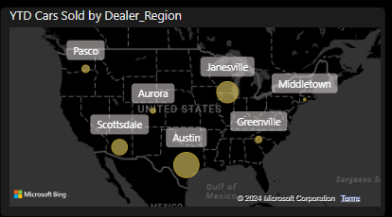
YTD Cars Sold by Dealer Region:
Overview: The map highlights the distribution of car sales across various dealer regions in the United States.
Key Regions:
Austin shows the largest volume of sales, indicated by the size of the circle.
Other significant markets include Scottsdale, Aurora, and Greenville.
Regional Spread: Sales are widespread but show higher concentrations in central and southern regions.
Insight: Mapping sales by region can help identify strong markets and areas needing more focus or marketing efforts.

Slide 9
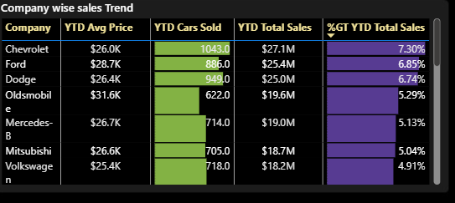
Company wise sales trend:
Overview:The "Company-wise Sales Trend" table provides a detailed comparison of various car manufacturers based on their year-to-date (YTD) sales performance.
Overall Summary
Chevrolet as a leader in both total sales and growth percentage.
The data indicates strong sales performance for Ford and Dodge as well, while brands like Volkswagen and Mitsubishi show lower figures, suggesting potential areas for improvement in their sales strategies.
The average price data also provides insights into market positioning, with Oldsmobile targeting a higher-end segment.

Slide 10
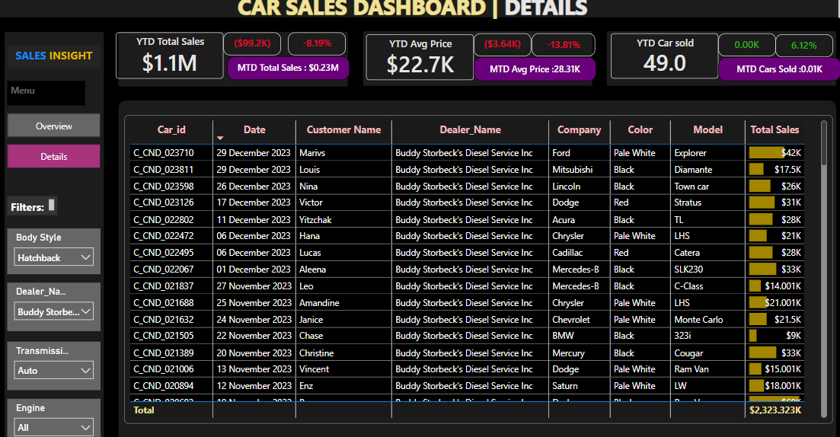
Details insights:
This section of the Car Sales Dashboard offers a detailed view of individual sales transactions, allowing for analysis of customer preferences, sales performance by model and colour, and overall dealership effectiveness.
The metrics indicate a decline in both total sales and average price, suggesting potential areas for improvement in sales strategies or inventory management.

Slide 11
Thank you

